Slide 1

교양으로 배우는 IT기술 Tech Talk 시리즈 - 2강 IT와 스마트시티-
School of EE, Kyungpook National University, Korea
Daejin Park
2020.06.18

Slide 2
Outline
Tech Talk 20분, 및 식사
대화 20분 (대학원생, 교수, 학생)
개별 모임 20분

Slide 3
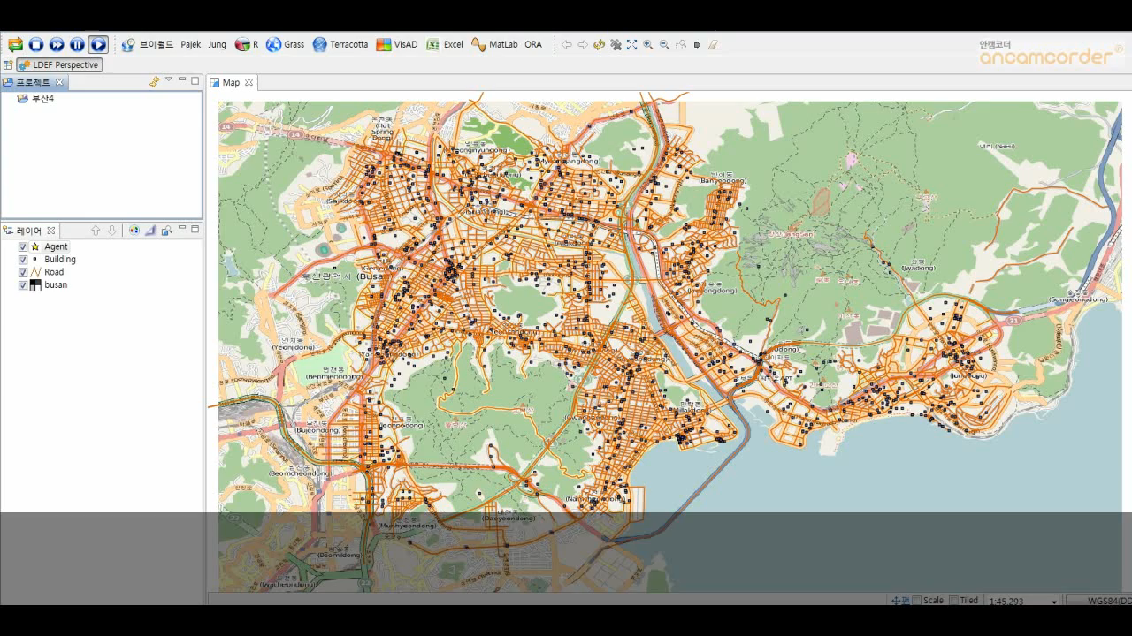
City Construction for Urban Evacuation

Slide 4
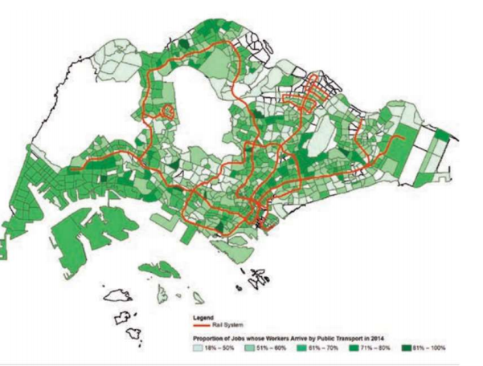
Land Use Planning
Tracking Mobile Devices, Gathering Big Data, Analyzing Activity
Gaining a Better Understanding of Needs of Citizens

Slide 5
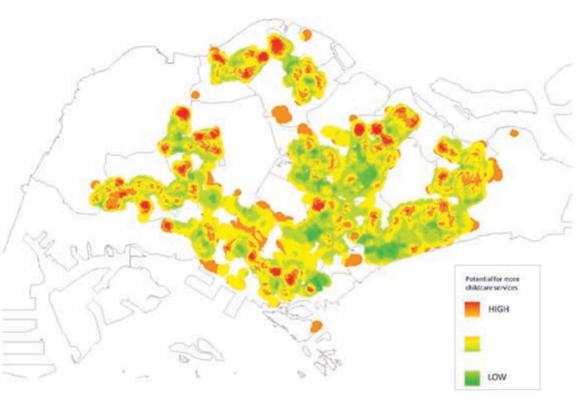
Efficient Distribution of Resources
Police station, childcare center, emergency center, hospital

Slide 6
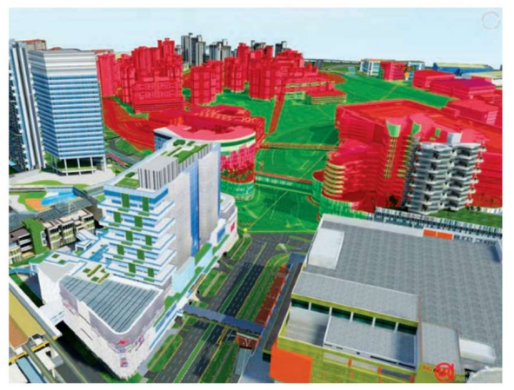
3D Urban Model for Onlooker Perspective
Enabling planners and architects to visualize and assess the impact of ongoing and future consistency

Slide 7
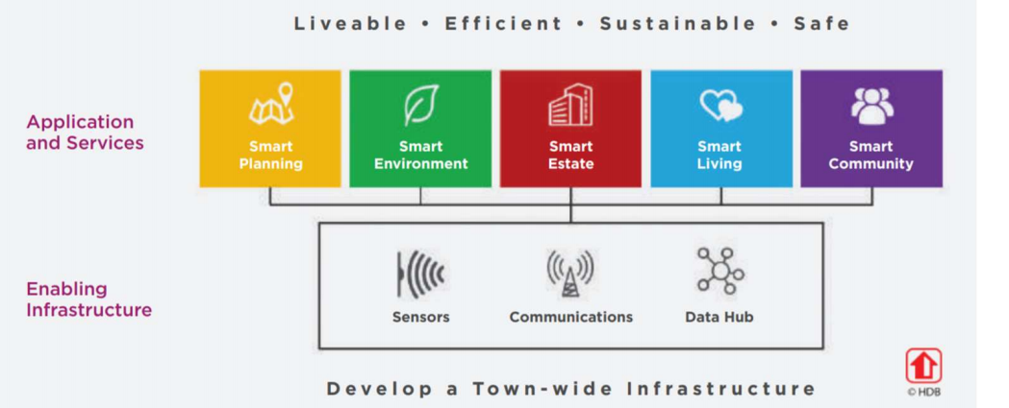
IoT 기반 IT, 환경, 부동산, 건설, 서비스 융합

Slide 8
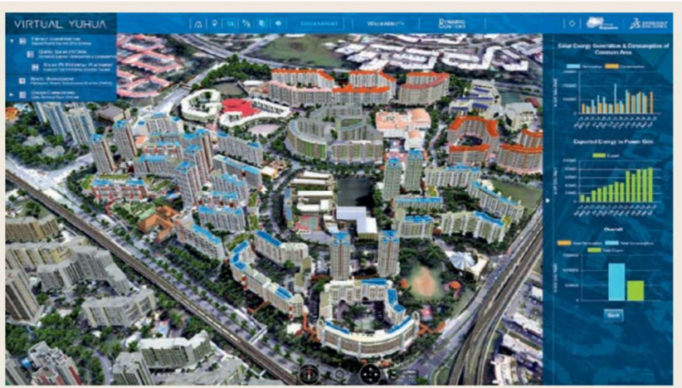
에너지 소비 예측, 태양열 대체 가능여부

Slide 9
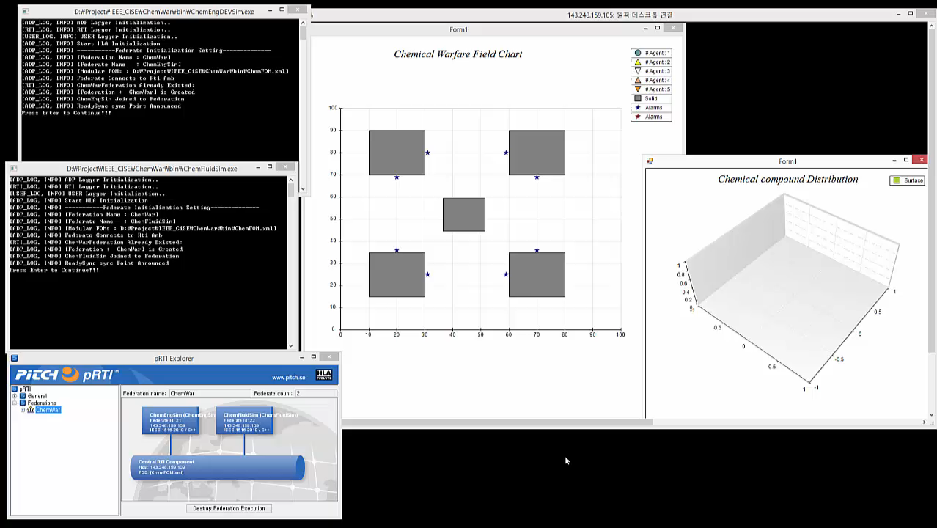
사람-건물-환경 상호작용 시뮬레이션
감지 센서 개수 위치 조절
보행자 수 제한, 필요한 병원 등

Slide 10



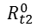
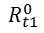
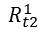
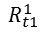
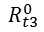
Connected Healthcare
Social Community와 Connected Network상의 Smart Sensor Devices와 통합
Wheelchair
user
Network/Social/ Service Layer
y
τ1
Online Social Networks
Node
τ2
Virtual node community
Family
Relationship
Map
x
τ3
v12
Friend
Relationship
τ4
v15
Connection
t
t1
t2
t3
v14
v13
v
WBSN
y
τ1
$$R_{t2}^{0}$$
$$R_{t1}^{0}$$
$$R_{t3}^{0}$$
Commmunity
τ2
Daejin Park
x
τ3
Physical
Smart Devices
Interaction
$$R_{t1}^{1}$$
τ4
$$R_{t2}^{1}$$
t1
t2
t3
t
Time : T=i
Position:P2
Activity
10m
Raw Trajectory
Big Data
Time : T=i-1
Position:P1
100m

Slide 11
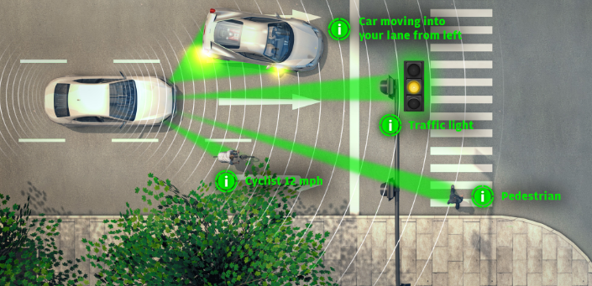
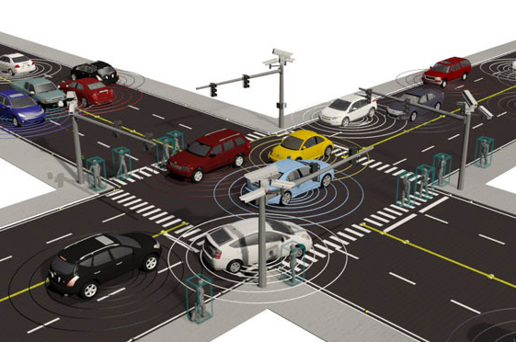
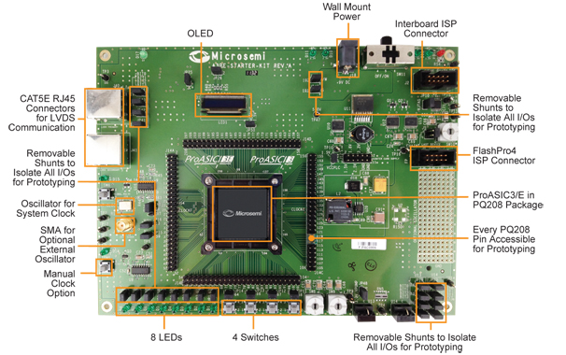
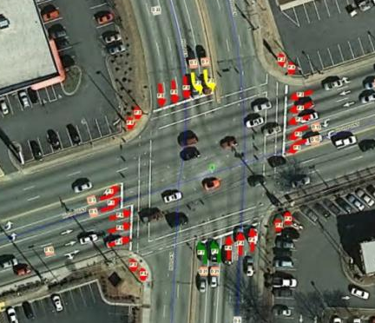
Connected Automotive
Automotive Software Platform
Big Data, Cloud Connected Autonomous Traffic System
ECU Sensor Signal Processing Platform
Drone-based Traffic Big Data

Slide 12
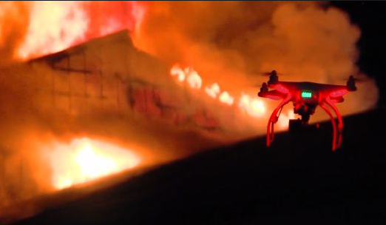
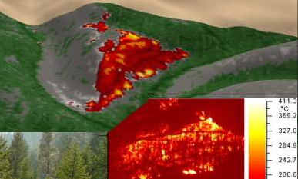
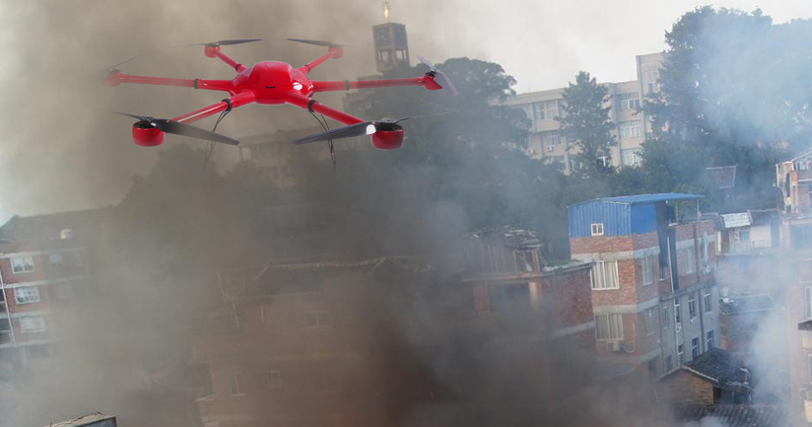
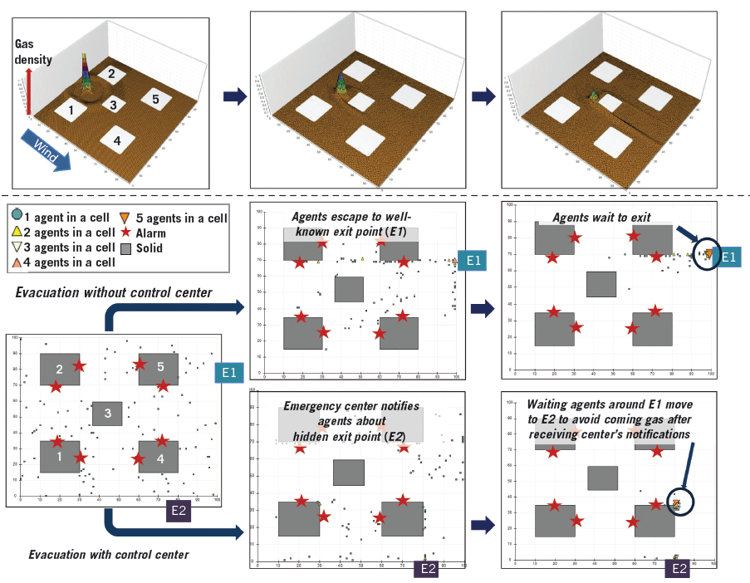
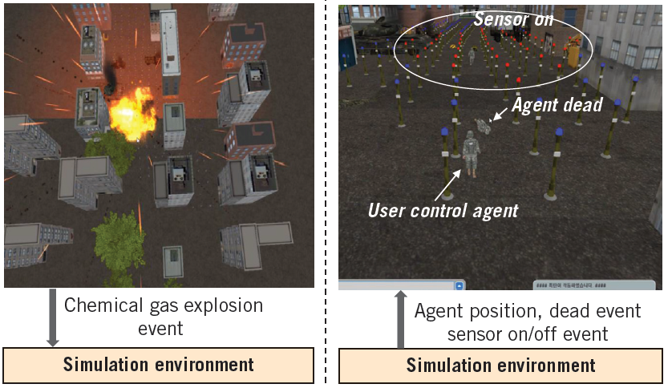
Connected Safety
영상 처리 서버, 빅데이타 관리, 특이점 판독 알고리즘..
군집 (Self-Organizing) Drone Software 기반 화재 감시
Discrete-Event Driven Simulation of Self-Organizing Smart Objects

Slide 13

for Emotional Things (IT+CT+BT+ST+FT+ET)

